Slide 1
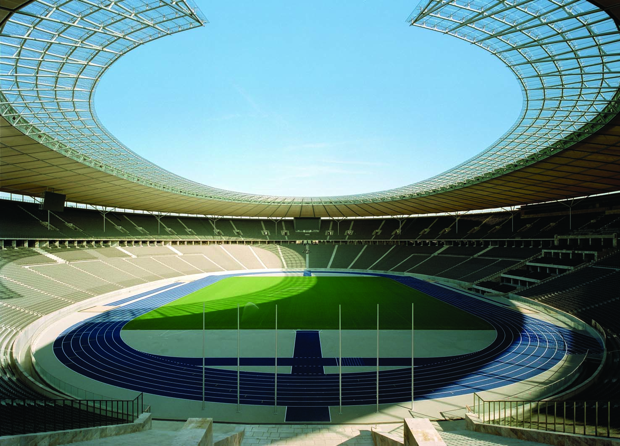
6
THE ECONOMICS OF LABOUR MARKETS

Slide 2
18
The Markets for the Factors of Production

Slide 3

Figure 1 The Versatility of Supply and Demand
(a) The Market for Apples
(b) The Market for Apple Pickers
Price of
Wage of
Apples
Apple
Pickers
Supply
Supply
P
W
Demand
Demand
0
Q
Quantity of
0
L
Quantity of
Apples
Apple Pickers
Copyright©2003 Southwestern/Thomson Learning

Slide 4

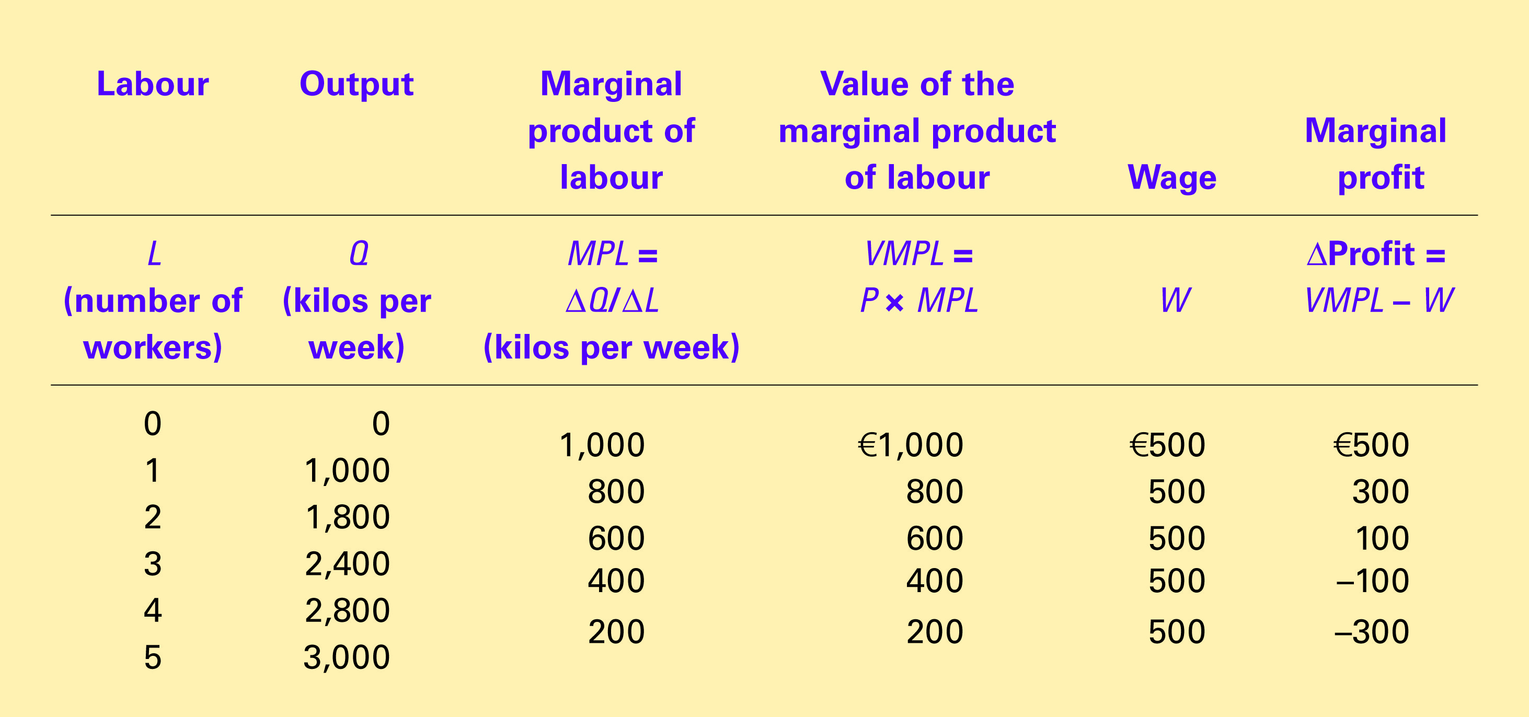
Table 1 How the Competitive Firm Decides How Much Labour to Hire
Copyright©2004 South-Western

Slide 5
Figure 2 The Production Function
Quantity
of Apples
Production
300
function
280
240
180
100
0
1
2
3
4
5
Quantity of
Apple Pickers
Copyright©2003 Southwestern/Thomson Learning

Slide 6
Figure 2 The Production Function
Quantity
of Apples
Production
300
function
280
240
180
100
0
1
2
3
4
5
Quantity of
Apple Pickers
Copyright©2003 Southwestern/Thomson Learning

Slide 7
Figure 3 The Value of the Marginal Product of Labour
Value
of the
Marginal
Product
Market
wage
Value of marginal product
(demand curve for labour)
0
Quantity of
0
Profit-maximizing quantity
Apple Pickers
Copyright©2003 Southwestern/Thomson Learning

Slide 8
Figure 4 Equilibrium in a Labour Market
Wage
(price of
labour)
Supply
0
Quantity of
labour
Copyright©2003 Southwestern/Thomson Learning

Slide 9
Figure 4 Equilibrium in a Labour Market
Wage
(price of
labour)
Supply
Equilibrium
wage,
W
Demand
0
Equilibrium
Quantity of
employment,
L
labour
Copyright©2003 Southwestern/Thomson Learning

Slide 10
Figure 5 A Shift in Labour Supply
Wage
(price of
1. An increase in
Supply,
S
labour supply . . .
labour)
S
W
W
2. . . . reduces
the wage . . .
Demand
0
L
L
Quantity of
labour
3. . . . and raises employment.
Copyright©2003 Southwestern/Thomson Learning

Slide 11
Figure 6 A Shift in Labour Demand
Wage
(price of
Supply
labour)
W
1. An increase in
labour demand . . .
W
2. . . . increases
the wage . . .
D
Demand,
D
0
L
L
Quantity of
labour
3. . . . and increases employment.
Copyright©2003 Southwestern/Thomson Learning

Slide 12
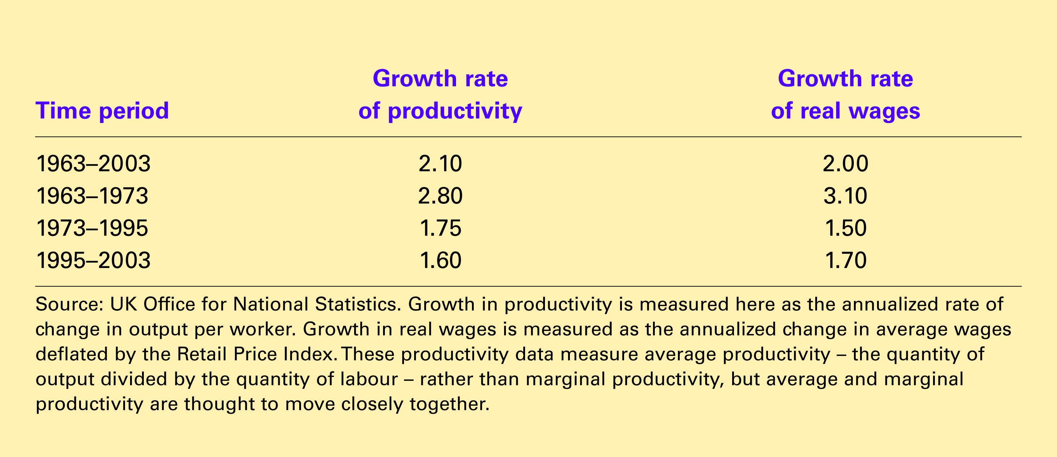
Table 2 Productivity and Wage Growth (%) in the United Kingdom.
Copyright©2004 South-Western

Slide 13
Figure 7 The Markets for Land and Capital
(a) The Market for Land
(b) The Market for Capital
Rental
Rental
Price of
Supply
Price of
Supply
Land
Capital
P
P
Demand
Demand
0
Q
Quantity of
0
Q
Quantity of
Land
Capital
Copyright©2003 Southwestern/Thomson Learning

